Slide 1





The 24th Conference of
Open Innovations Association - FRUCT
Moscow, Russia, April 11, 2019
Building Detection on Aerial Images
Using U-NET Neural Networks
Leonid Ivanovsky
Vladimir Khryashchev
Vladimir Pavlov
Anna Ostrovskaya

Slide 2
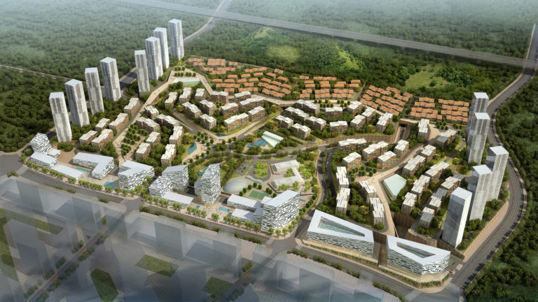
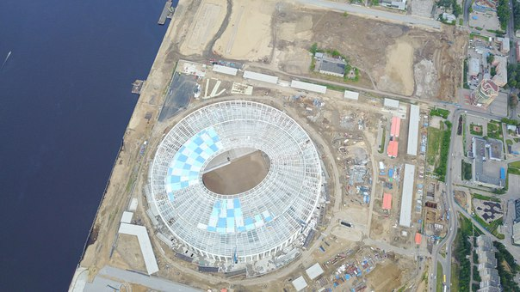
Purpose
Development of effective algorithm for building detection on satellite images based on convolutional neural network

Slide 3
Algorithm requirements
Take into account the small size of objects
Be invariant to rotation
Have enough training examples
Have an ability to handle huge pictures
Cope with noise

Slide 4
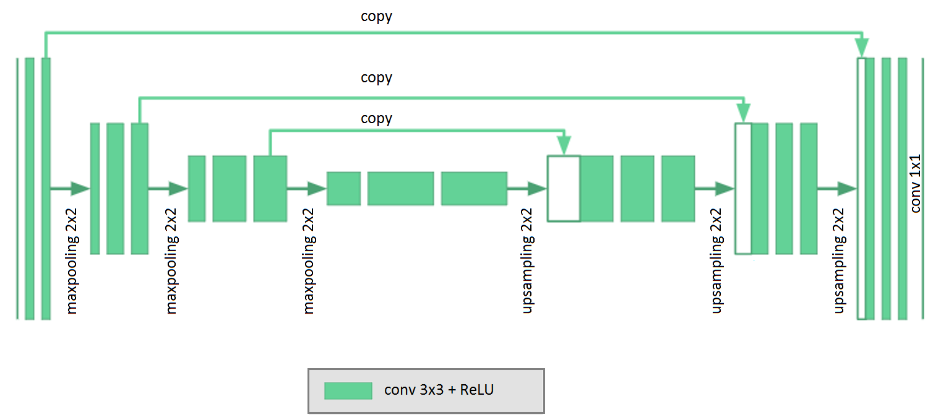
U-Net
Trainable parameters: 7.8 mil

Slide 5
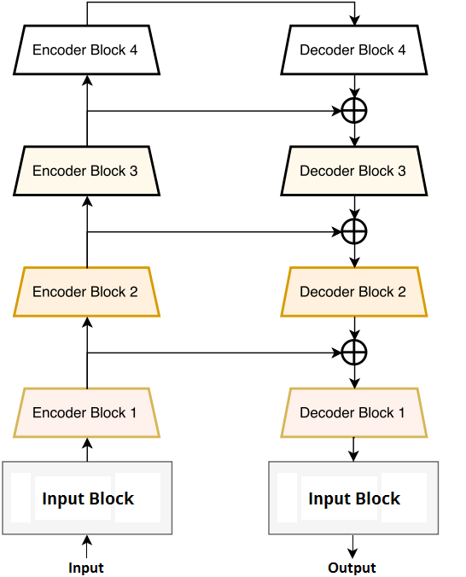
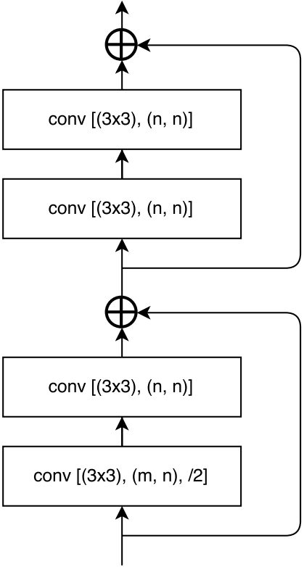
LinkNet
Trainable parameters: 17.2 mil

Slide 6
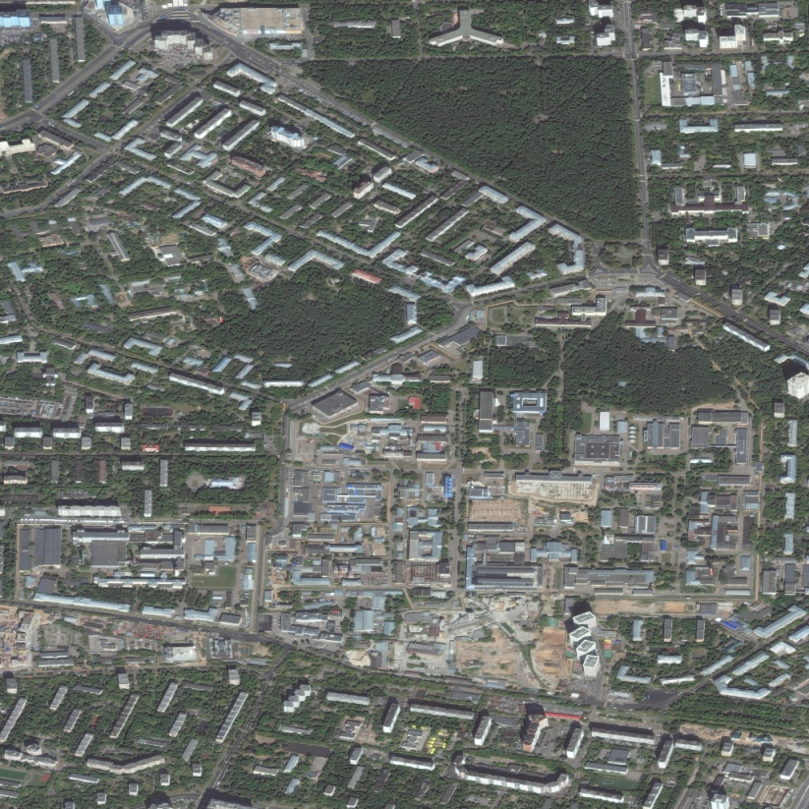
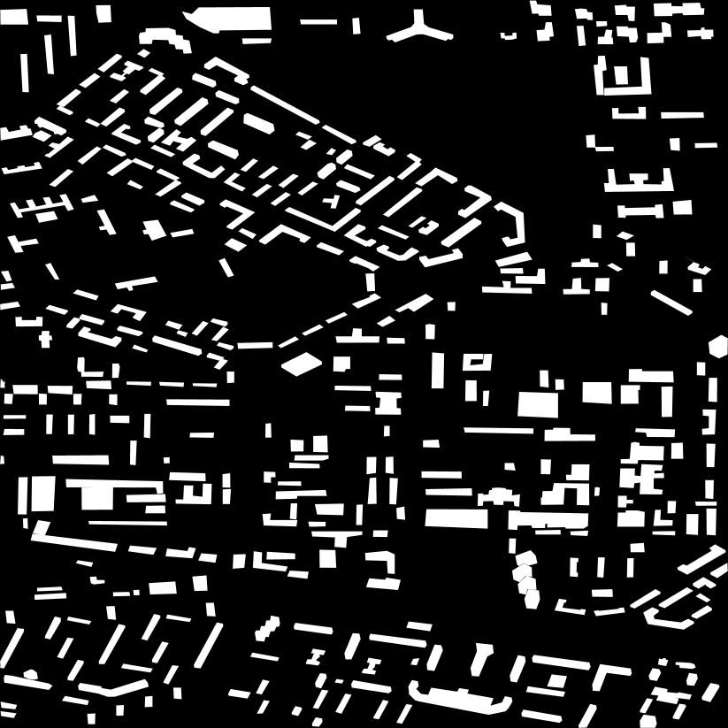
Planet database
14 samples in JPG format
Resolution: 16384x16384 px, 0.5 m/pixel
3 Russian cities: Moscow, Yaroslavl, Rybinsk

Slide 7
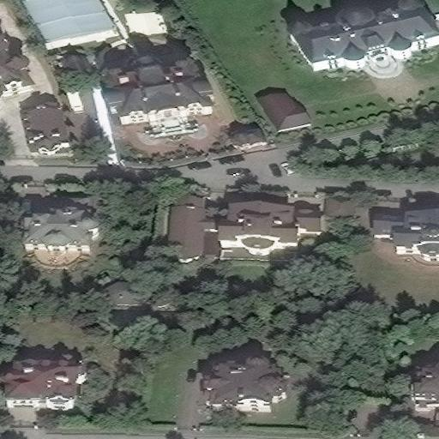
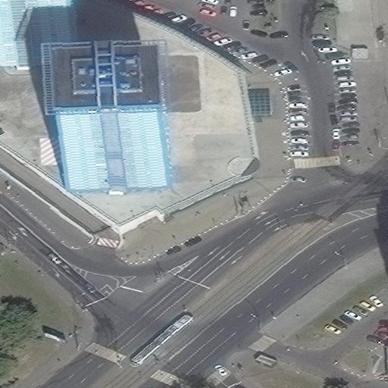
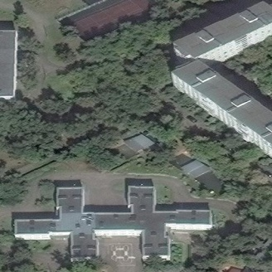
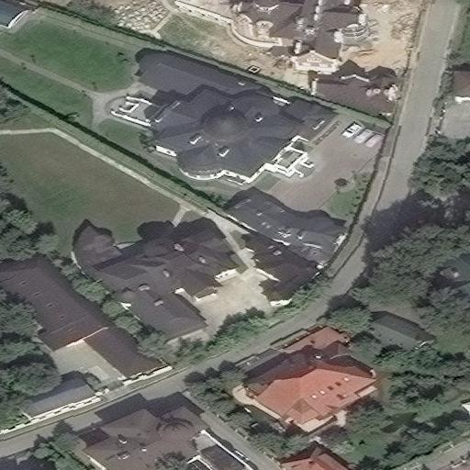
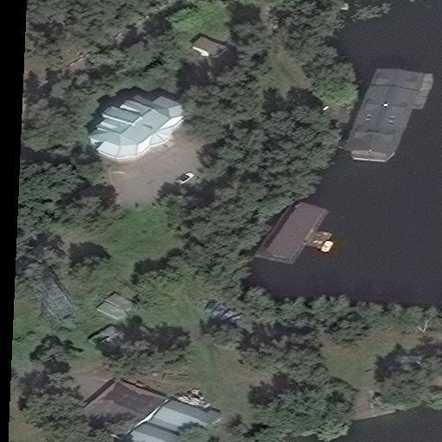
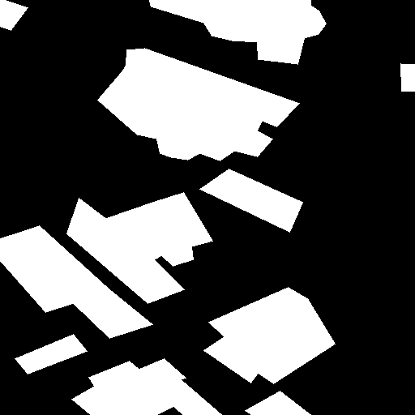




Dataset preparation
Cropped image resolution: 512x512 px
Training set: 2611 images
Test set: 653 photos

Slide 8
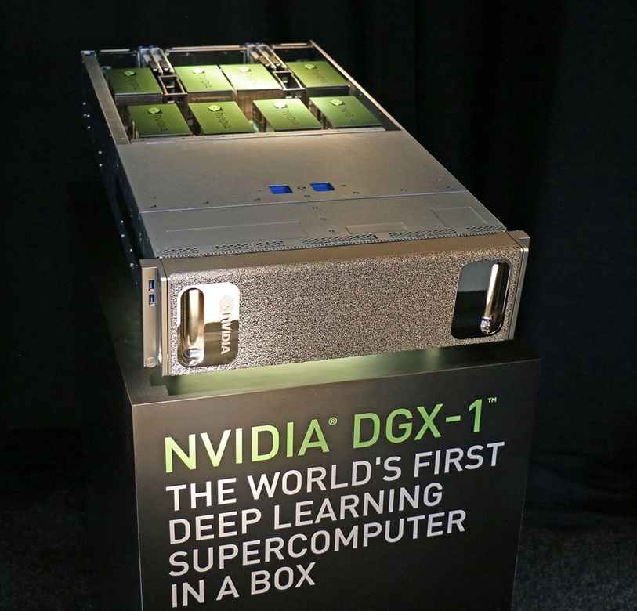

Training and testing
Loss function: binary cross-entropy
Optimizer: Adam
Batch size: 18 samples
Epochs (E): 96

Slide 9
Numerical results
Model | Accuracy
U-Net | 96.31%
LinkNet | 95.85%
Model | Sorensen-Dice coefficient (DSC)
U-Net | 0.77
LinkNet | 0.72

Slide 10
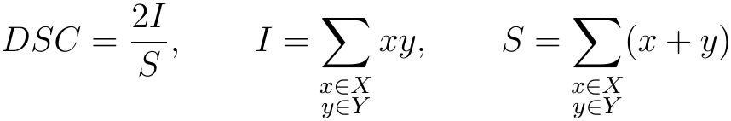
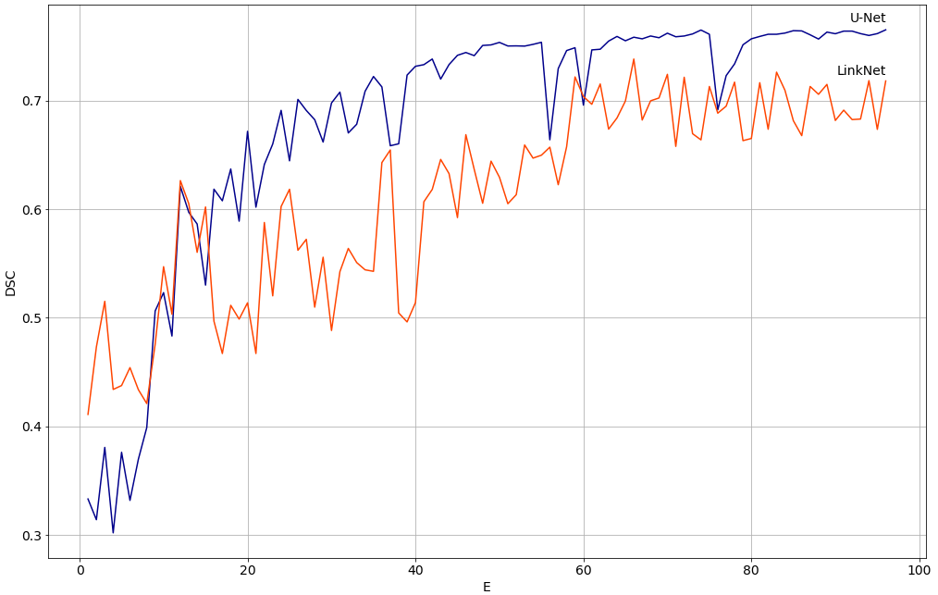
Numerical results

Slide 11
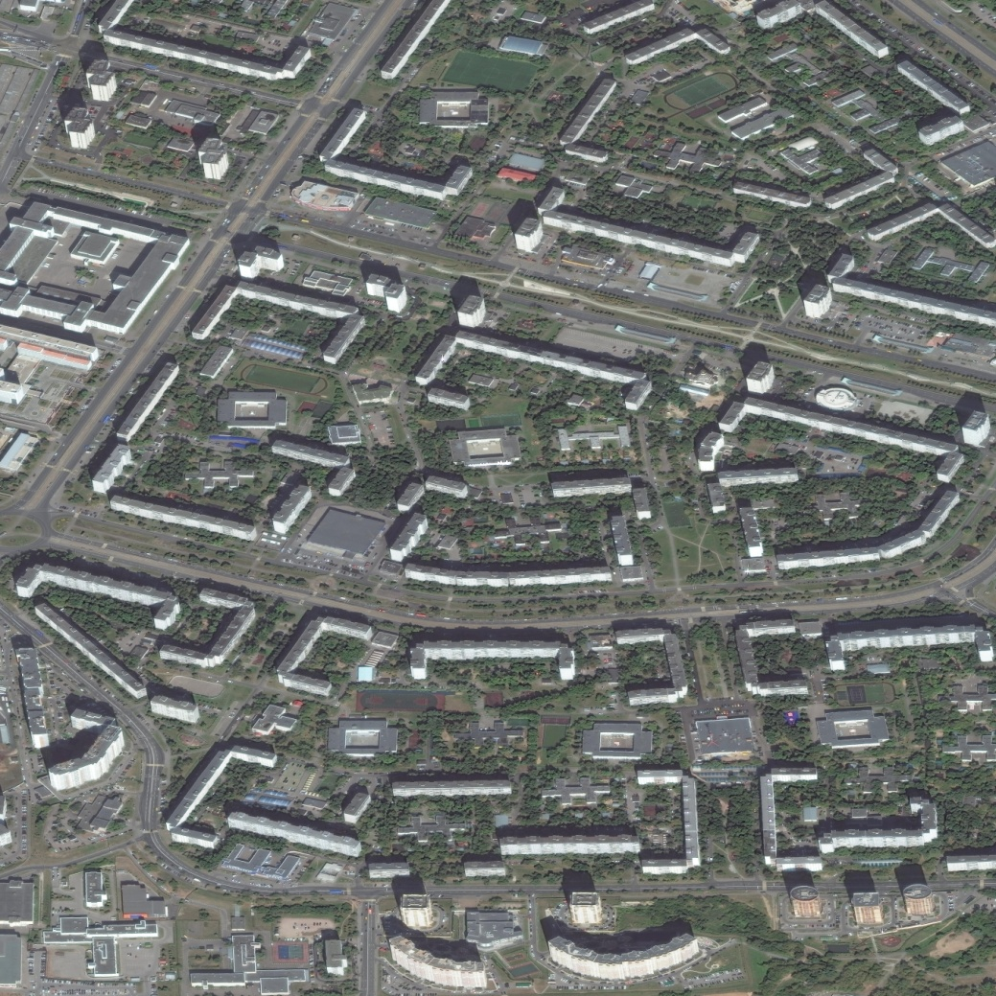
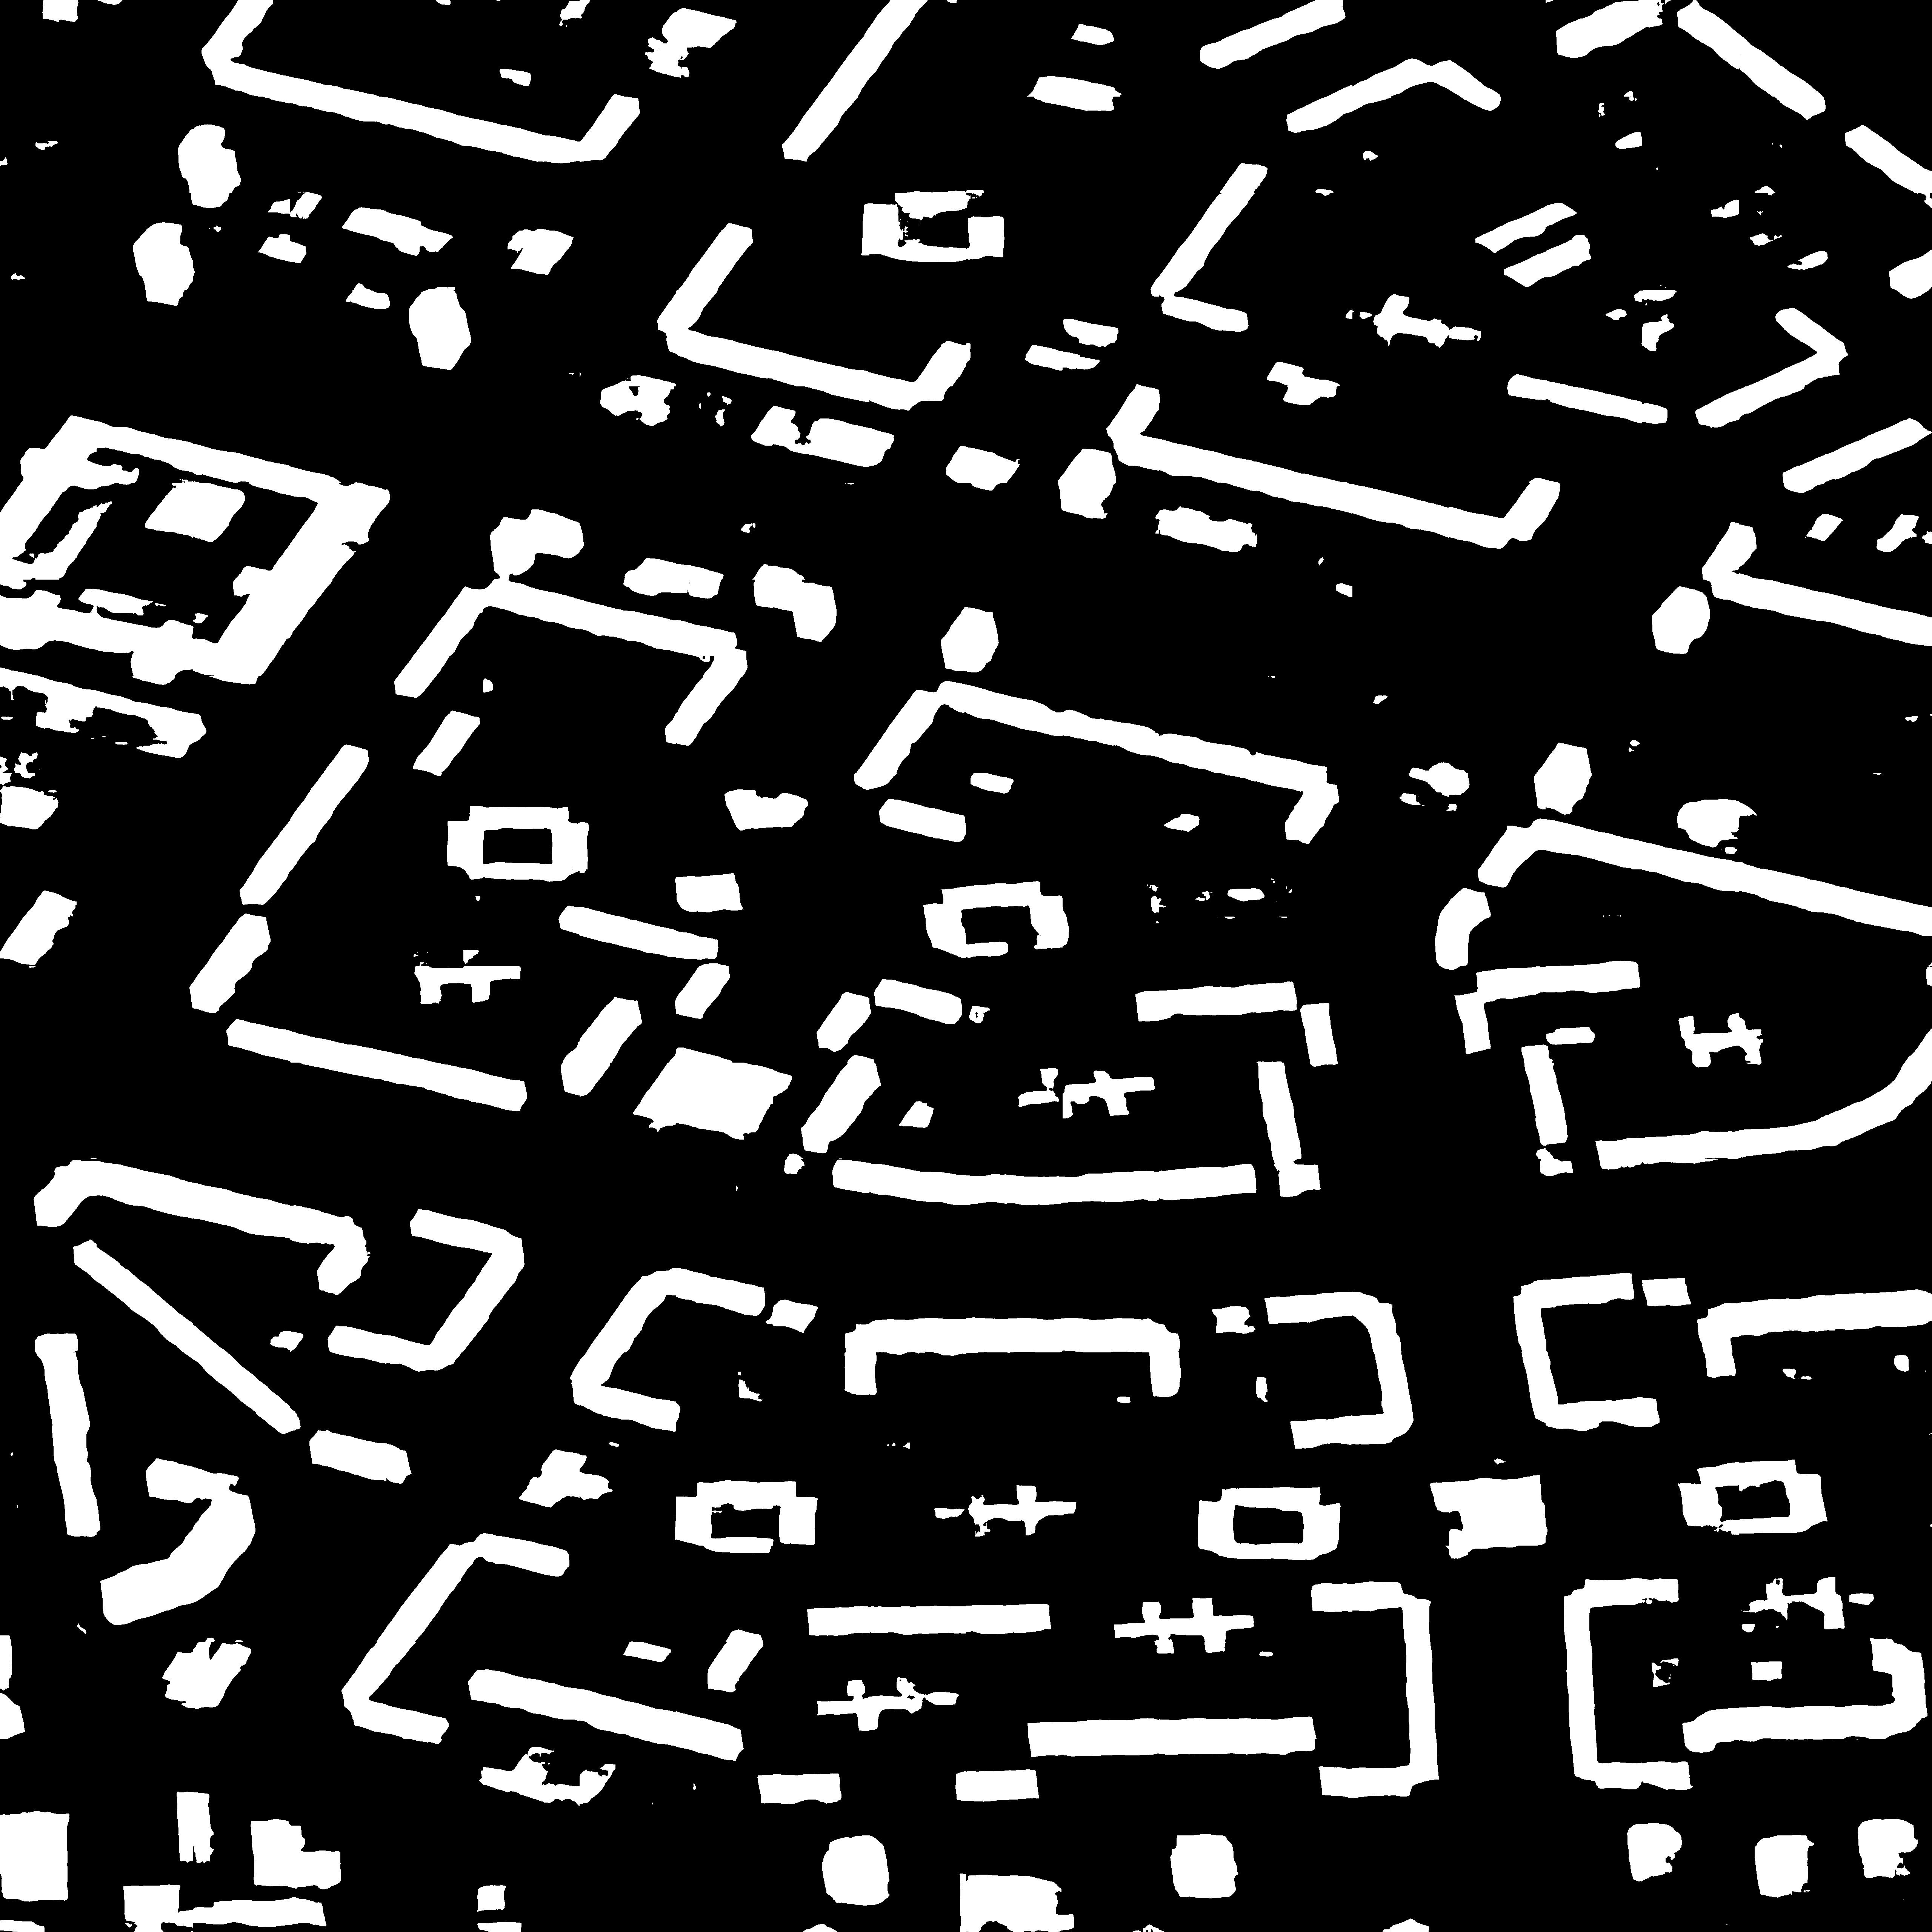
Examples of detection

Slide 12
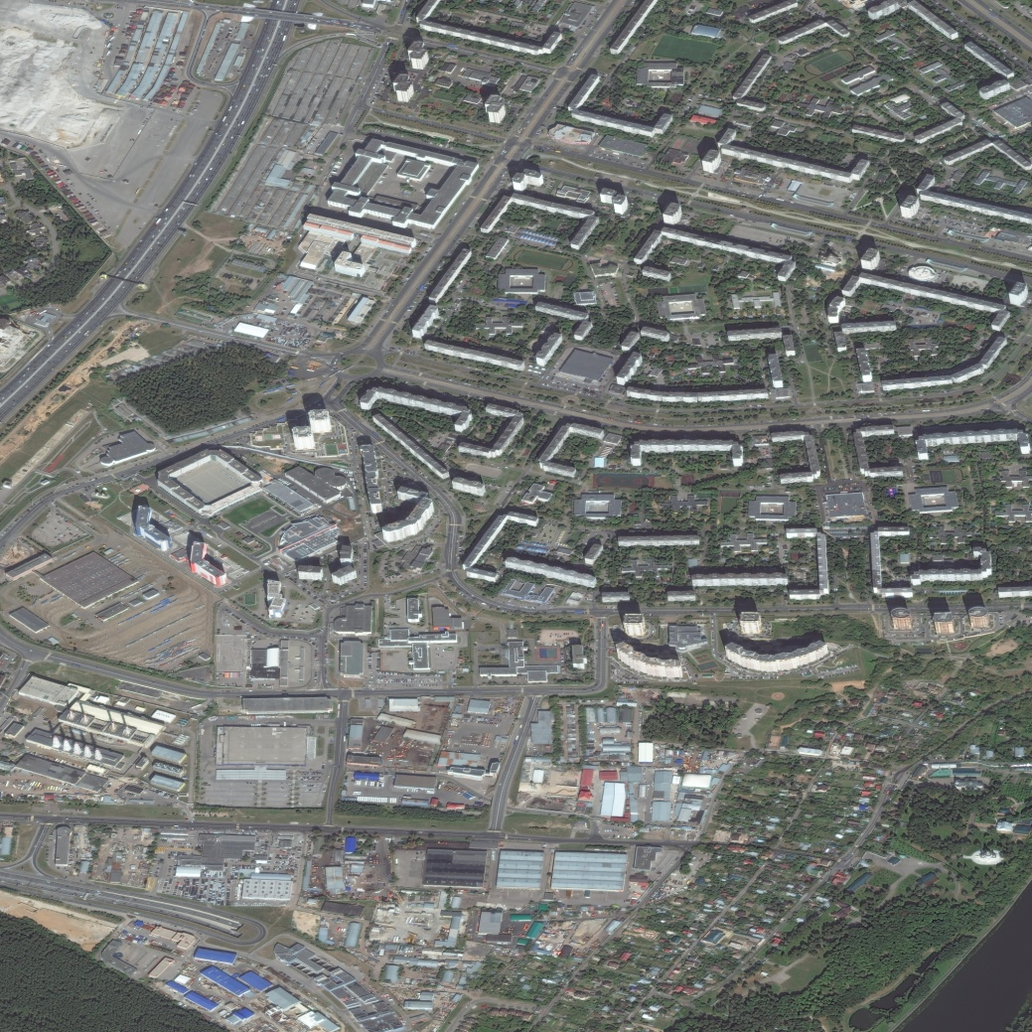
Examples of detection

Slide 13
Conclusions
Convolutional neural networks can be effectively used for building detection on aerial photos
Dice similarity coefficient (DSC) shows the difference in application of various algorithms of deep learning
The best performance was given by using U-Net

Slide 14

Acknowledgment
The work was prepared with the financial support of the Ministry of Education of the Russian Federation as part of the research project No. 14.575.21.0167 connected with the implementation of applied scientific research id. RFMEFI57517X0167

Slide 15
The 24th Conference of
Open Innovations Association - FRUCT
Moscow, Russia, April 11, 2019
Building Detection on Aerial Images
Using U-NET Neural Networks
Leonid Ivanovsky
Vladimir Khryashchev
Vladimir Pavlov
Anna Ostrovskaya

